Slide 1
Title I Annual Parent Meeting
PINELLAS PARK HIGH SCHOOL
August 24, 2021

Slide 2
About Title I
Title I is the largest federal assistance program for our nation’s schools.
The goal of Title I is to address the academic needs of students and to assist them in meeting their state’s academic standards.
The program serves 75 schools in Pinellas County including eligible students in 34 non-public schools.

Slide 3
Title I Funding
Pinellas County Schools
Increased Student Achievement
Federal Government
1
3
2
4
Florida Department of Education
Pinellas Park High School
Notes:
The Florida Department of Education receives funds from the federal government. Districts receive Title I funds from Department of Education, and the school district distributes these funds to schools based on the percentage of children eligible for free/reduced price lunch; however, students do not have to be from low-income families to receive help.

Slide 4
Pinellas Park High School is provided funds to pay for supplemental resources and programs for increased student achievement.
Supplemental Definition: provided in addition to what is already present or available to complete or enhance it.
https://languages.oup.com/
Notes:
Title I is supplemental federal funding that provides extra academic support and learning opportunities.

Slide 5
How Title I Provides Supplemental Support at PPHS
Supplemental Resource | Positive Impact
Additional supplemental personnel – Success Coaches | Ensure intervention for closing achievement gaps; build consensus for multi-tiered systems of support and collaborative problem solving; help teachers provide immediate support to students in need; ensure equity and learning for all students; build a foundation on shared values, standards, vision; implement, monitor, and achieve results
Parent and Family Engagement Resources and Training Workshops | Effective communication between all stakeholders ensures student success
Supplemental teaching materials, equipment, and technology – Supply stations for students | Supplies are available for students…no one should be without resources necessary for success
Notes:
Use additional slides if necessary. This is where you want to really highlight Title I funding and how it positively impacts your scholars! Additional supplemental personnel (add specific positions)

Slide 6
PPHS’s Title 1 21-22 Budget
Full-time personnel - $238,008.68
Curriculum development - $718.20
Instructional resources - $6,553.12
Family Engagement Allocation - $4,868
Total Allocation - $250,148

Slide 7
Title I Schoolwide Planning
First
Second
Last
Input from school, family, and community members determine how Title I funds are used based on a needs assessment.
Please attend online or in-person meetings/trainings and complete surveys to provide input on Title I funding.
All Title I schools must document that parents are involved in the schoolwide planning process.

Slide 8
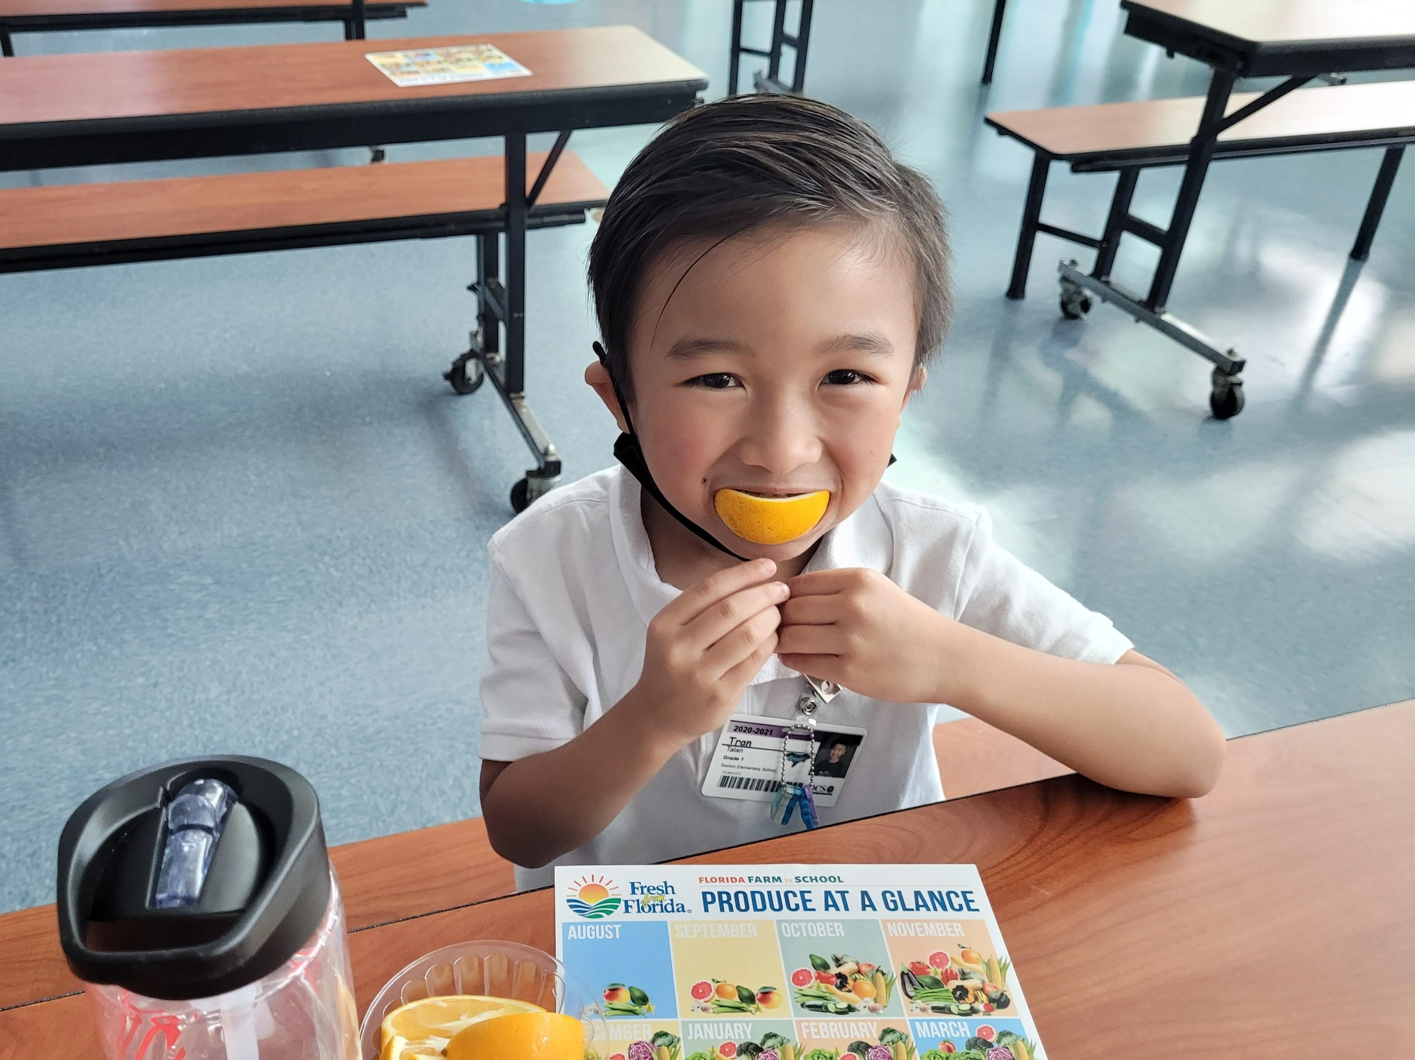
Parent’s Right to Know
As a parent of a student attending a Pinellas County School Public School, you have the right to…
Be provided information on your child’s level of achievement on assessments in Reading/Language Arts, Writing, Mathematics, and Science.
Request and receive information on the qualifications of your child’s teacher and supplemental personnel working with your child.
Be notified of non-highly qualified or out-of-field teachers at the school.
Be informed if your child is taught by a non-highly qualified teacher for four or more consecutive weeks.

Slide 9
Working Together for Student Success
As a Title I parent you have the right to be involved in the development of the following plans and documents for our school which can be found on our website www.pcsb.org/pp-hs to view as well as in the Parent Station located in our Guidance office.
School Improvement Plan (SIP)
Title I Schoolwide Plan
Parent and Family Engagement Plan (PFEP)
School-Parent-Student Compact
Notes:
Our school’s Title I Parent Station is located in our front Guidance office and on the webpage.
You will find a copy of our School Improvement Plan, Title I Schoolwide Plan, School’s PFEP, the School District’s PFEP, Parent’s Right to Know Memo, Upcoming Events, Compact, (insert other documents at your station)

Slide 10
Parent-School-Student Compact
The purpose of the compact is to foster student achievement. By signing the Parent-School-Student Compact, (Insert name of school here), teachers, staff, parents and students agree to work together to share the responsibility of helping students meet or exceed state, district and school academic goals.
The Parent-School-Student Compact is updated every year to include parent, student, teacher, and staff input. Parent, student, teacher and staff comments are welcome at any time during the year.
Please review and sign your child’s Compact.
Our goal is to receive 100% participation!

Slide 11
Parent and Family Engagement Plan (PFEP)
The PFEP Sections include information about the following:
Parent trainings to increase student achievement
Staff trainings for engaging parents
Communication methods between home and school
Flexible meeting times
Accessibility for parents
Coordinating with other Federal Programs
Notes:
Provide information on the specific committees that parents can be involved. Include the purpose, date and time of meetings.
Explain the PFEP and its purpose.

Slide 12
We want YOU!
School Advisory Council (SAC)
Parent Advisory Council (PAC)
The District has a Parent and Family Engagement Plan. The summary of the this plan is in the Title I School & Family Partnership Overview.
You may access the full plan at www.pcsb.org/titleone
PAC is responsible for reviewing and revising the District PFEP; SAC is responsible for reviewing schoolwide plans.
If you are interested in representing our school please notify, Brett Patterson.

Slide 13
Working Together for Student Success
Please join us…Pinellas Park High School’s SAC meetings occur at 6:00pm on the 3rd Tuesday each month.

Slide 14
Accountability
School Report Cards
School Grade and Overview
Population and Enrollment
Assessments – Academic Achievement, Growth, and Population
Assessments – English Language Learners
Graduation and Beyond
Educator Qualifications and Equity
Long-Term Goals and Interim Progress
Accelerated Course Enrollment
Per-Pupil Expenditures
National Data
Available online at https://edudata.fldoe.org/ or Front Office

Slide 15
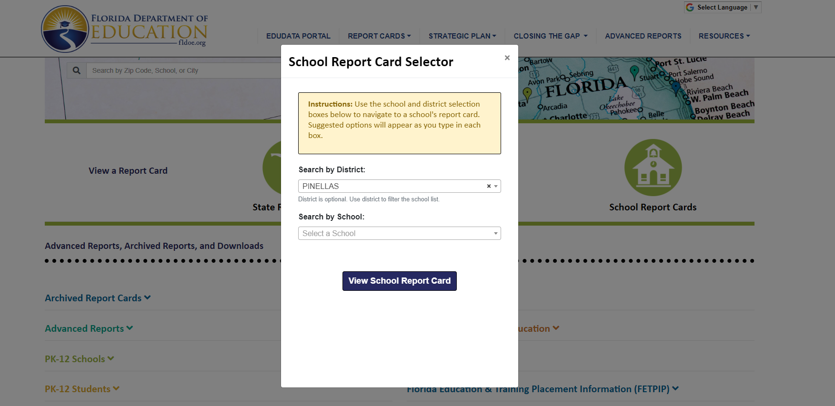
Visit to find district and school grades, EduData Portal
Notes:
When you follow the link EduDataPortal select Pinellas County and search by school.

Slide 16
Florida Standards
Florida’s academic content standards establish high expectations for all students.
Florida Standards identify what your child needs to know and be able to do in all content areas. You may read more information by visiting fldoe.org/academic/standards/.
Also, your child’s teacher will be able to explain the standards for your child’s grade level.
Notes:
All curriculum, instruction and assessments are based on student-centered expectations.

Slide 17
Florida Benchmark For Excellent Student Thinking Standards (B.E.S.T). You may read more information by visiting, http://www.fldoe.org/standardsreview/
Notes:
All curriculum, instruction and assessments are based on student-centered expectations.

Slide 18
Next Steps
We encourage you to…
Review the Compact throughout the year as it relates to your child(ren)’s goals
Communicate with the teachers and other staff
regularly
Participate in giving your input for our SIP, PFEP, and Compact

Slide 19
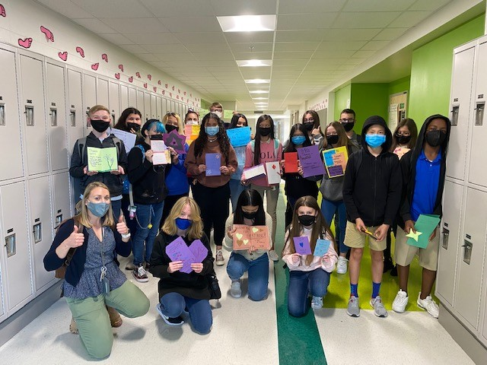
Additional Resources
Title I Parent & Family Coordinator – Amy Brown
brownamyl@pcsb.org
Learning at Home Family Resources - https://www.pcsb.org/Page/32836
Volunteer in a Pinellas County School - https://www.pcsb.org/Page/459
Parent Advocacy – Keosha Simmons simmonskeo@pcsb.org
Parent Academy POWER HOURS Webinars - https://www.pcsb.org/Page/26534
Partnerships - https://www.pcsb.org/Page/418

Slide 20
We appreciate your time!
Please feel free to ask any questions and provide feedback on our Title I Program.

Slide 21
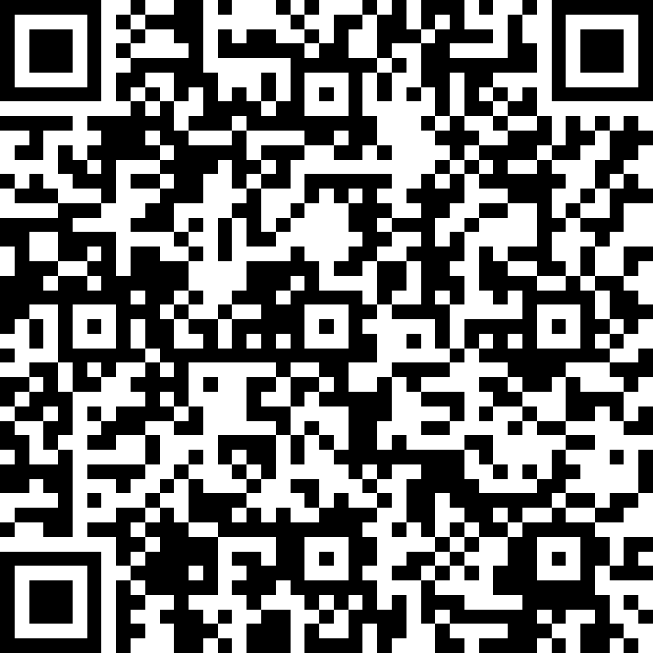
Please take the time to participate in our survey.
Scan the QR Code
Or copy and paste the link
https://forms.office.com/Pages/ResponsePage.aspx?id=BZM8c9c5GkaGb_3ye_PH_7EZ3z8p0zBHovHCWSKeLSJUNklBVFhXQk1SWFo0M1VGTjczOTZHNFA1SC4u
Your feedback is greatly appreciated!

